Slide 1
Chapter 11
Inheritance and Composition

Slide 2
Objectives (1 of 2)
In this chapter, you will:
Learn about inheritance
Learn about derived and base classes
Explore how to redefine the member functions of a base class
Examine how the constructors of base and derived classes work
Learn how the destructors of base and derived classes work

Slide 3

Objectives (2 of 2)
Learn how to construct the header file of a derived class
Become aware of stream classes hierarchy
Explore three types of inheritance: public, protected, and private
Learn about composition (aggregation)
Become familiar with the three basic principles of object-oriented design

Slide 4
Introduction
Two common ways to relate two classes in a meaningful way are:
Inheritance (“is-a” relationship)
Composition or aggregation: (“has-a” relationship)

Slide 5

Inheritance (1 of 5)
Inheritance is an “is-a” relationship
Example: “every employee is a person”
Inheritance allows creation of new classes from existing classes
Derived classes: new classes created from the existing classes
Base class: the original class
A derived class inherits the properties of its base classes

Slide 6

Inheritance (2 of 5)
Inheritance helps reduce software development complexity
Single inheritance: derived class has a single base class
Multiple inheritance: derived class has more than one base class
Public inheritance: all public members of base class are inherited as public members by derived class

Slide 7
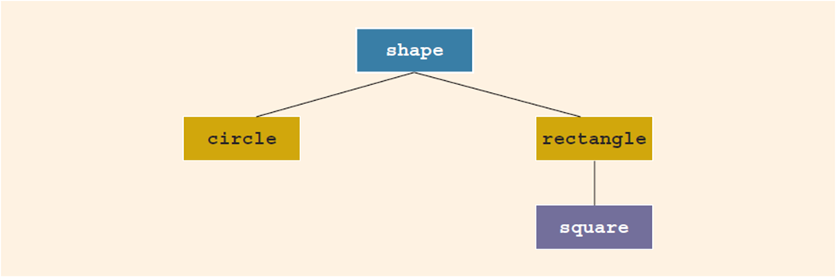

Inheritance (3 of 5)
Inheritance can be viewed as a tree-like, or hierarchical, structure between the base class and its derived classes
FIGURE 11-1 Inheritance hierarchy

Slide 8
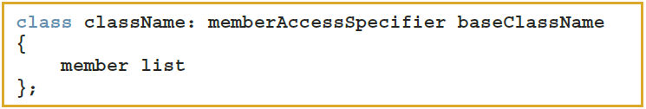

Inheritance (4 of 5)
Syntax of a derived class:
memberAccessSpecifier is public, protected, or private (default)
private members of a base class are private to the base class
Derived class cannot directly access them

Slide 9
Inheritance (5 of 5)
public members of the base class can be inherited as public or private members
The derived class can include additional members (data and/or functions)
The derived class can redefine public member functions of the base class
Applies only to the objects of the derived class
All member variables of the base class are also member variables of the derived class

Slide 10


Redefining (Overriding) Member Functions of the Base Class (1 of 3)
To redefine a public member function:
The corresponding function in the derived class must have the same name, number, and types of parameters
If the derived class overrides a public member function of the base class, then to call the base class function, specify the:
Name of the base class
Scope resolution operator
Function name with appropriate parameter list

Slide 11
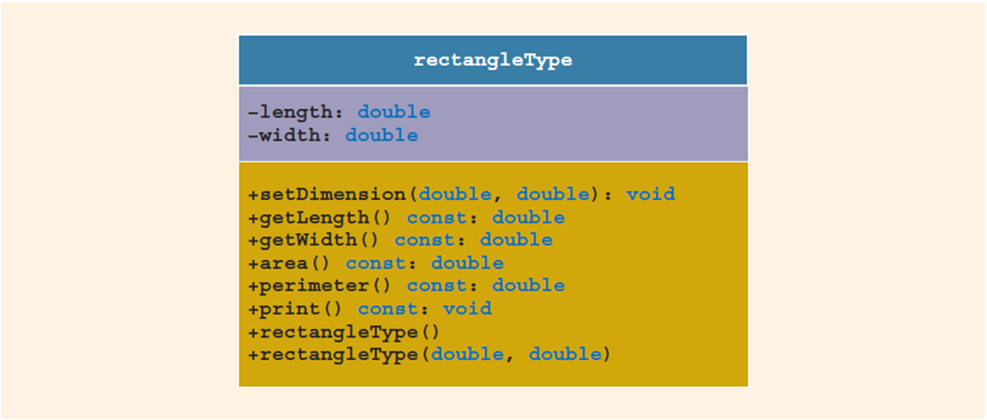

Redefining (Overriding) Member Functions of the Base Class (2 of 3)
FIGURE 11-2 UML class diagram of the class rectangleType

Slide 12
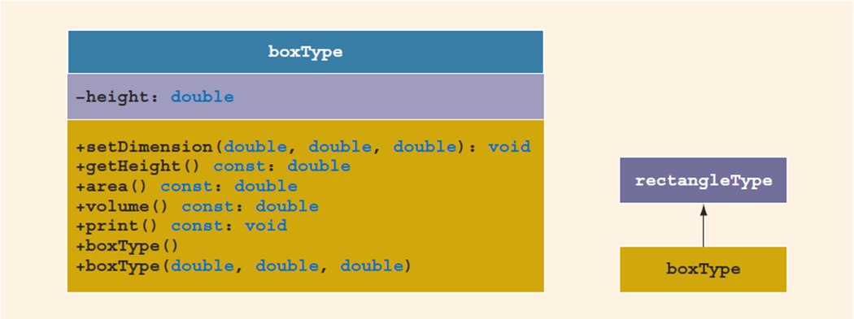

Redefining (Overriding) Member Functions of the Base Class (3 of 3)
boxType is derived from rectangleType, and it is a public inheritance
Also overrides the functions print and area
FIGURE 11-3 UML class diagram of the class boxType and the inheritance hierarchy

Slide 13

Constructors of Derived and Base Classes
A derived class constructor cannot directly access private members of the base class
Can directly initialize only public member variables of the base class
When a derived object is declared, it must execute one of the base class constructors
A call to the base class constructor is specified in the heading of the derived class constructor definition

Slide 14

Destructors in a Derived Class
Destructors deallocate dynamic memory allocated by the objects of a class
When a derived class object goes out of scope
Automatically invokes its destructor
When the destructor of the derived class executes
Automatically invokes the destructor of the base class

Slide 15
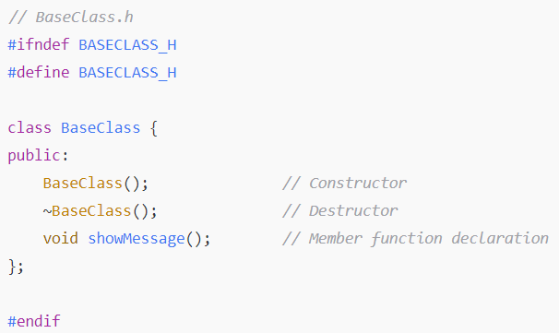
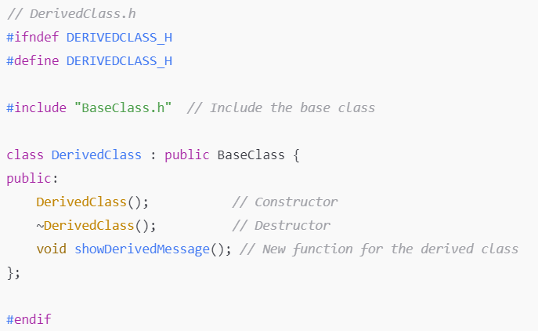

Header File of a Derived Class
To define new classes, create new header files
To create new derived classes, include commands that specify where the base class definitions can be found
Definitions of the member functions can be placed in a separate file

Slide 16
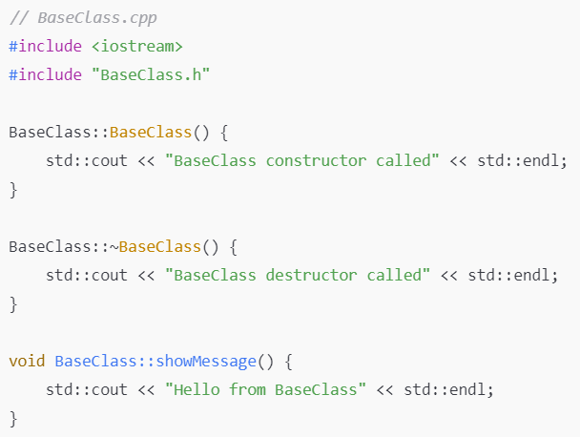
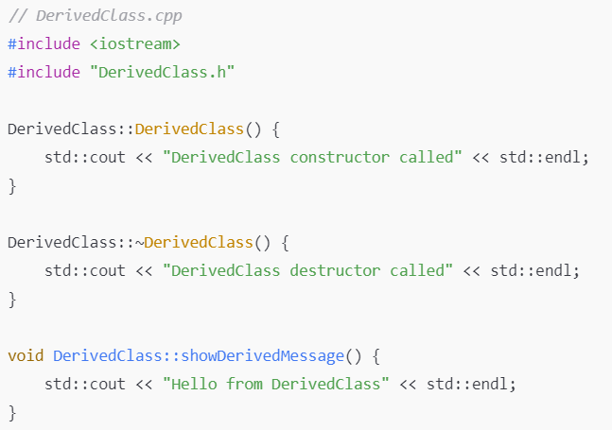
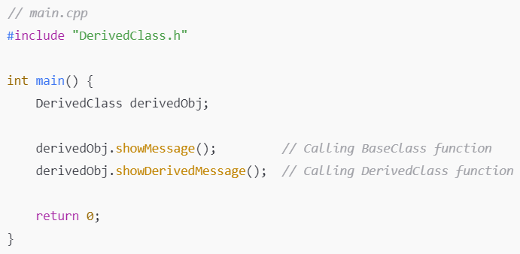


Slide 17
Multiple Inclusions of a Header File
Use the preprocessor command (#include) to include a header file in a program
The preprocessor processes the program before it is compiled
To avoid multiple inclusions of a file in a program, use certain preprocessor commands in the header file

Slide 18
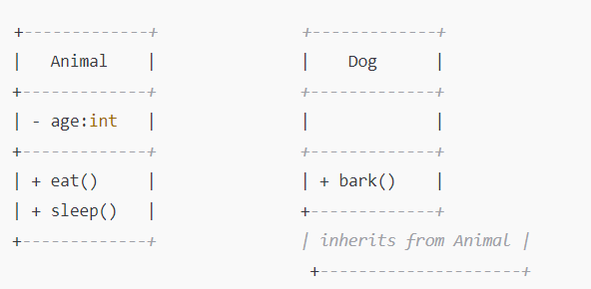
Example 1: Inheriting from a Base Class Animal

Slide 19
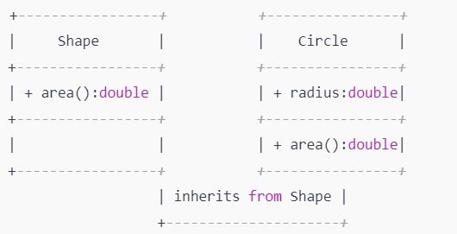
Example 2: Inheriting from a Base Class Shape

Slide 20
Ex1: Vehicle Management System
In this example, we’re going to design a Vehicle Management System that could be used in a real-world scenario like a car rental service, a transportation company, or an automotive inventory system. Each type of vehicle in the system shares some common properties, but each type may also have its own unique features.

Slide 21
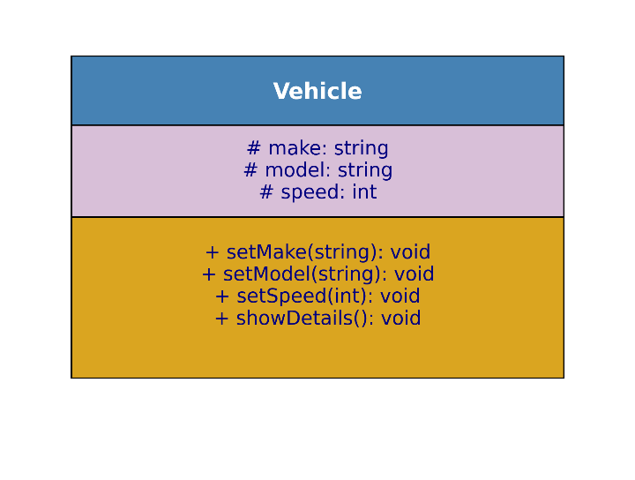
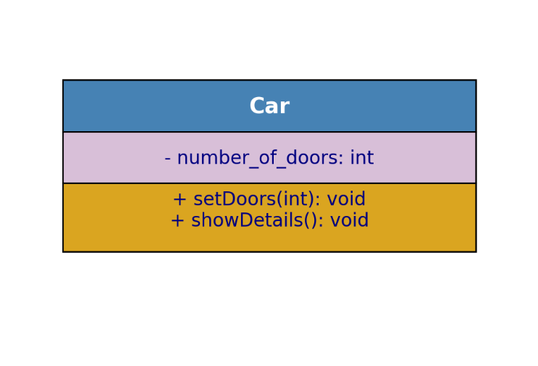
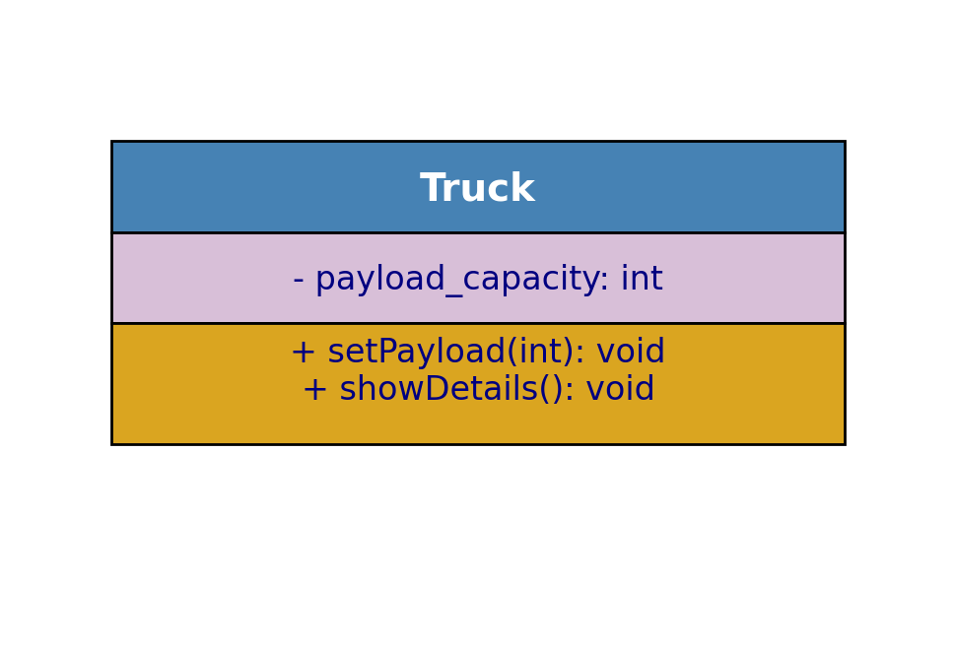
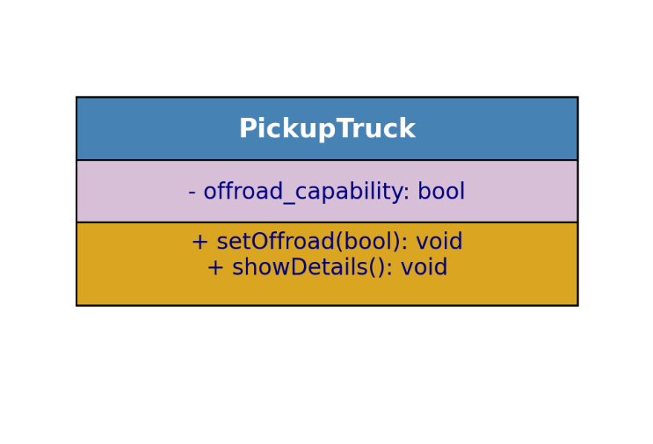

Slide 22
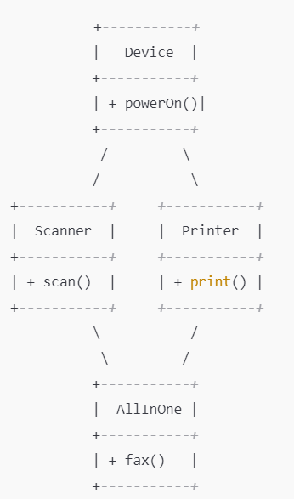
Example 2: Handling the Diamond Problem with Virtual Inheritance

Slide 23
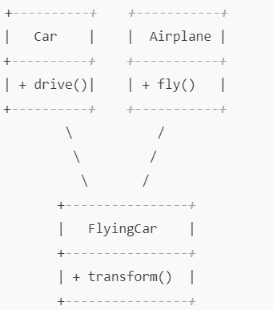
Design a class hierarchy for a FlyingCar that combines features of both a Car and an Airplane.

Slide 24
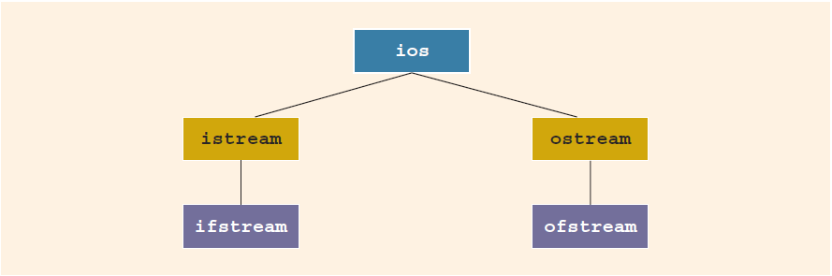
C++ Stream Classes (1 of 2)
ios is the base class for all stream classes
Contains formatting flags and member functions to access/modify the flag settings
FIGURE 11-6 C11 stream classes hierarchy

Slide 25


C++ Stream Classes (2 of 2)
istream and ostream provide operations for data transfer between memory and devices
istream defines the extraction operator
and functions get and ignore
ostream defines the insertion operator
which is used by cout
ifstream and ofstream objects are for file I/O
Header file fstream contains the definitions for these

Slide 26
Protected Members of a Class
A derived class cannot directly access private members of it base class
To give it direct access, declare that member as protected

Slide 27
Inheritance as public, protected, or private (1 of 3)
Assume class B is derived from class A with
class B: memberAccessSpecifier A
If memberAccessSpecifier is public:
public members of A are public in B and can be directly accessed in class B
protected members of A are protected in B and can be directly accessed by member functions (and friend functions) of B
private members of A are hidden in B and can be accessed only through public or protected members of A

Slide 28
Inheritance as public, protected, or private (2 of 3)
If memberAccessSpecifier is protected:
public members of A are protected members of B and can be accessed by the member functions (and friend functions) of B
protected members of A are protected members of B and can be accessed by the member functions (and friend functions) of B
private members of A are hidden in B and can be accessed only through public or protected members of A

Slide 29
Inheritance as public, protected, or private (3 of 3)
If memberAccessSpecifier is private:
public members of A are private members of B and can be accessed by member functions of B
protected members of A are private members of B and can be accessed by member functions (and friend functions) of B
private members of A are hidden in B and can be accessed only through public or protected members of A

Slide 30
Composition (Aggregation) (1 of 2)
In composition, one or more member(s) of a class are objects of another class type
Composition (aggregation) is a “has-a” relation
Arguments to the constructor of a member-object are specified in the heading part of the definition of the constructor

Slide 31
Composition (Aggregation) (2 of 2)
Member-objects of a class are constructed in the order they are declared
Not in the order listed in the constructor’s member initialization list
They are constructed before the containing class objects are constructed

Slide 32
ExamplesLibrary and Books
Create a Library class that contains a few Book objects. Each Book has only a title. The Library should be able to add books and display the list of books.

Slide 33
Problem for Practice: School and Students
Create a School class that contains a few Student objects. Each Student has only a name. The School should be able to add students and display the list of students.

Slide 34
Object-Oriented Design (OOD) and Object-Oriented Programming (OOP) (1 of 5)
The fundamental principles of object-oriented design (OOD) are:
Encapsulation: combines data and operations on data in a single unit
Inheritance: creates new objects (classes) from existing objects (classes)
Polymorphism: the ability to use the same expression to denote different operations

Slide 35
OOD and OOP (2 of 5)
In OOD:
Object is a fundamental entity
Debug at the class level
A program is a collection of interacting objects
OOD encourages code reuse
Object-oriented programming (OOP) implements OOD

Slide 36
OOD and OOP (3 of 5)
C++ supports OOP through the use of classes
A function name and operators can be overloaded
A polymorphic function or operator has many forms
Example: division with floating point and division with integer operands

Slide 37
OOD and OOP (4 of 5)
Templates provide parametric polymorphism
C++ provides virtual functions to implement polymorphism in an inheritance hierarchy
Allows run-time selection of appropriate member functions
Objects are created when class variables are declared
Objects interact with each other via function calls

Slide 38
OOD and OOP (5 of 5)
Every object has an internal state and an external state
Private members form the internal state
Public members form the external state
Only the object can manipulate its internal state

Slide 39
Identifying Classes, Objects, and Operations (1 of 5)
To find classes, begin with a problem description and identify all nouns and verbs
From the list of nouns choose the classes
From the list of verbs choose the operations
Suppose we want to write a program that calculates and prints the volume and surface area of a cylinder

Slide 40
Identifying Classes, Objects, and Operations (2 of 5)
State this problem as follows:
Write a program to input the dimensions of a cylinder and calculate and print the surface area and volume
Nouns are bold and verbs are italic
From the list of nouns, one can visualize a cylinder as a class (cylinderType) from which we can create many cylinder objects of various dimensions

Slide 41
Identifying Classes, Objects, and Operations (3 of 5)
These nouns are characteristics of a cylinder, so they will not be classes:
Dimensions
Surface area
Volume
Next, determine three pieces of information about this class:
Operations that an object can perform
Operations that can be performed on an object
Information that an object must maintain

Slide 42
Identifying Classes, Objects, and Operations (4 of 5)
From the verbs, list possible operations that an object of that class can perform, or have performed, on itself
For the cylinderType class:
Input
Calculate
Print
Dimensions of the cylinder represent the class’s data

Slide 43
Identifying Classes, Objects, and Operations (5 of 5)
Identifying classes via nouns and verbs from problem descriptions is not the only technique possible
There are several other OOD techniques in the literature

Slide 44
Quick Review (1 of 4)
Inheritance and composition are meaningful ways to relate two or more classes
Inheritance is an “is-a” relation
Single inheritance: a derived class is derived from one class, called the base class
Multiple inheritance: a derived class is derived from more than one base class
Composition is a “has-a” relation

Slide 45
Quick Review (2 of 4)
private members of a base class are private to the base class
public members of a base class can be inherited either as public or private
A derived class can redefine function members of a base class
Redefinition applies only to objects of derived class

Slide 46
Quick Review (3 of 4)
A call to a base class constructor (with parameters) is specified in the heading of the definition of the derived class constructor
When initializing object of a derived class, the base class constructor is executed first
In composition (aggregation):
A class member is an object of another class
A call to constructor of member objects is specified in heading of the definition of class’s constructor

Slide 47
Quick Review (4 of 4)
Three basic principles of OOD:
Encapsulation
Inheritance
Polymorphism
To find classes:
Describe the problem
Choose classes from the list of nouns
Choose operations from the list of verbs

